Slide 1
SENTIMENT ANALYSIS FOR MARKETING
PHASE 1 – ARTIFICIAL INTELLIGENCE

Slide 2
PROBLEM STATEMENT AND DEFINITION
PROBLEM STATEMENT : Sentiment analysis for marketing
PROBLEM DEFINITION : The problem is to perform sentiment analysis on customer feedback to gain insights into competitor products. By understanding customer sentiments,companies can identify strengths and weekness in competing products, thereby improving their own offerings. This project require utilizing various NLP methods to extract valuable insights from customer feedback.
We have done the analysis for twitter airline dataset

Slide 3
PROCESSES
Data Collection
Data Preprocessing
Sentiment Analysis Techniques
Feature Extraction
Visualization
Insights Generation

Slide 4
DATA COLLECTION
For this problem we have taken The Twitter Airline Sentiment dataset, it contains customer reviews about several airlines.
The Twitter Airline Sentiment dataset was created by Crowdflower in February 2015. The dataset contains over 140,000 tweets from US airlines customers. The tweets were labeled as positive, negative, or neutral, and the negative tweets were further categorized into different reasons, such as late flights, rude service, and lost baggage.
The dataset has been taken from https://www.kaggle.com/datasets/crowdflower/twitter-airline-sentiment

Slide 5
DATA PREPROCESSING
Remove punctuation: We can use a regular expression to remove all punctuation marks from the text data.
Remove stop words: Stop words are common words that do not add much meaning to the text, such as "the", "is", and "and". We can remove stop words using a pre-defined list of stop words.
Convert text to lowercase: This will help to ensure that different variants of the same word are treated the same.
Lemmatization or stemming: Lemmatization and stemming are two techniques for reducing words to their root form. Lemmatization is more sophisticated and accurate, but it is also more computationally expensive. Stemming is faster and simpler, but it can be less accurate.

Slide 6
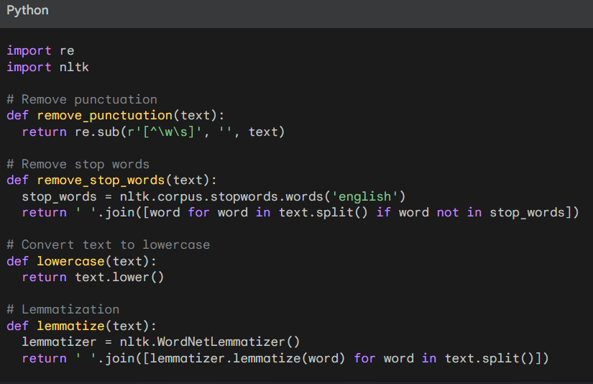
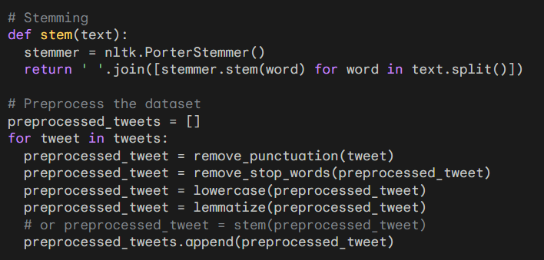
THE PYTHON CODE FOR PREPROCESSING

Slide 7
SENTIMENT ANALYSIS TECHNIQUES
BAG OF WORDS MODEL:
The Bag of Words (BoW) model is a simple but effective technique for sentiment analysis. It represents text as a vector of word counts, where each element in the vector represents the number of times a particular word appears in the text.
WORD EMBEDDINGS:
Word embeddings are a more sophisticated technique for representing text than the BoW model. Word embeddings represent words as vectors of numerical values that capture their meaning and relationships to other words.

Slide 8
EXAMPLE FOR BOW METHOD
For example, consider the following sentence:
"The flight was delayed and the customer service was rude."
The BoW model would represent this sentence as the following vector:
[1, 1, 1, 1, 1]
where the words "flight", "delayed", "customer", "service", and "rude" each appear once in the sentence.
The BoW model can be used to train a sentiment analysis model by feeding it a set of labeled training data.
The model will learn to associate certain words with positive or negative sentiment. For example,
the word "delayed" is likely to be associated with negative sentiment, while the word "excellent“
is likely to be associated with positive sentiment.
Once the model has been trained, it can be used to predict the sentiment of new text data.
To do this, the model simply counts the number of times each word in the new text data appears
in the training data. The model then predicts the sentiment of the new text data based on the sentiment of the words that it contains.

Slide 9
FEATURE EXTRACTION
Feature Extraction
Identify the features that are relevant to sentiment analysis. Some common features include:
The number of positive and negative words in the text
The sentiment scores of the words in the text
The presence of certain keywords, such as "excellent", "poor", or "disappointed"
Extract the features from the text data. This can be done using a variety of methods, such as:
Using a regular expression to count the number of positive and negative words in the text
Using a sentiment dictionary to assign sentiment scores to the words in the text
Using a pre-trained word embedding model to represent the words in the text as vectors of numerical values

Slide 10
VIZUALIZATION
Visualization
Once the features have been extracted, we can create visualizations to depict the sentiment distribution and analyze trends. Some common visualizations for sentiment analysis include:
Word clouds: Word clouds are a simple but effective way to visualize the most common words in a text corpus. The size of each word in the word cloud is proportional to its frequency in the corpus.
Bar charts: Bar charts can be used to visualize the distribution of sentiment scores. For example, we could create a bar chart to show the percentage of positive, negative, and neutral tweets in a dataset.
Line charts: Line charts can be used to visualize sentiment trends over time. For example, we could create a line chart to show how the average sentiment of customer reviews has changed over time.

Slide 11
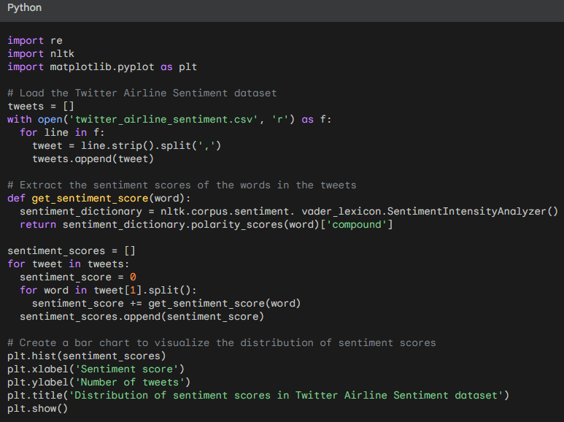
EXAMPLE CODE FOR VIZUALIZATION

Slide 12
MEMBERS
KISHORE RAVISHANKAR
PANDIARAJ SEKAR
RAJPRIYAN
TEENU
YUVARAJA
DHINESH

